Slide 1
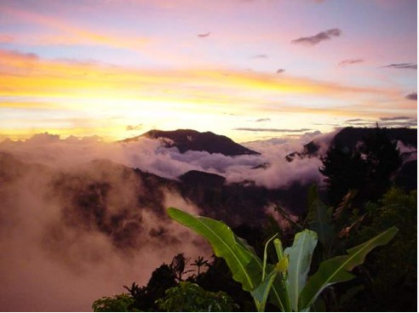
Costa Rica: a brief history for grad students
Notes:
Democratic republic: a country that is both a republic and a democracy
Republic: A state in which supreme power is held by the people and their elected representatives (Canada = constitutional monarchy)
National liberation party:

Slide 2
Democratic Republic
President Laura Chinchilla (2010), National Liberation Party
Gained independence 1821
Fair and democratic elections since 1948 civil war
Jose Figueres Ferrer, rebel leader
Military abolished in 1948
Only country in Latin America with uninterrupted political democracy over the last 60 years
Notes:
Democratic republic: a country that is both a republic and a democracy
Republic: A state in which supreme power is held by the people and their elected representatives (Canada = constitutional monarchy)
National liberation party:

Slide 3
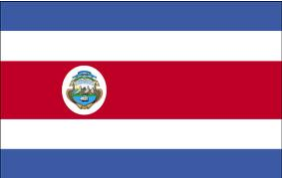
Costa Rica Exceptionalism
– stable democracy – human rights – conservation –
– rural democracy – ‘whiteness’ –institutional structures –
Notes:
Costa rica is seen as an exceptional country in Central America – both by costa ricans and by outsiders.
Why? Several explanations – myths –
-resource poor/low population meant the ecomienda system was not developed like in other latin american countries
-whiteness or europeanness
Current scholarship pinpoints the 1940s as key decade: 1949 constitution; 1946 electoral reforms;
Post-1948 – no military, instead investment in education, healthcare; interventionist state, institutional reforms to decrease power of president

Slide 4
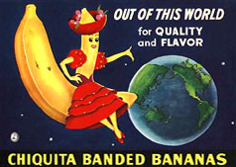
Economy
Primary exports
Agriculture: bananas, coffee, sugar
Hi-tech and pharmaceuticals
Ecotourism
Notes:
Coffee brought from ethiopia to Costa Rica via Arabian peninsula
Tax incentives for fdi + highly educated population have encouraged growth of hi-tech and pharma industries, now accounting for most of gdp – relative decline of agriculture
Intel 3500 employees in microprocessor plant; Proctor and Gamble;
conservation efforts, which we will be hearing all about, credited for the strength of tourism

Slide 5
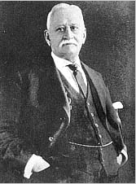
Coffee and bananas
Notes:
On the right – Henry Meiggs, real estate speculator, lumber baron, railroad builder. Colourful character. Began construction on Costa Rica railroad 1871
On the left – nephew Minor Cooper Keith – took over railroad construction 1877, founded UFC
Railroad from San Jose to Limon on Caribbean coast to bring coffee to Europe
Keith received 800,000 acres (5% of the country) and a 99-year lease on railroad operation. Started banana plantations, soon overtook coffee as main export, costa rica became the first ‘banana republic’

Slide 6
Notes:
Train route from San Jose to Limon
Best coffee grown in Tarrazu
Legend is that so many workers died they brought in Italian and Jamaican labourers – Jamaican community still on Caribbean
Keith’s 3 brothers also died in Costa Rica during construction

Slide 7
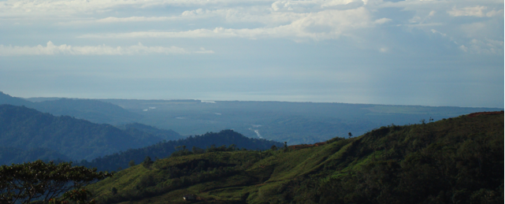
Coffee was first imported in 1779, and became the primary export commodity
Railroad construction led to the banana industry and relative decline of coffee
“look at the mess we’ve got ourselves into just because we invited a gringo to eat some bananas”
Gabriel Garcia Marquez, 100 Years of Solitude
Notes:
Railroad constructed between 1871 – 1890 to bring coffee from highlands to coast for European mkt
Keith paid in land – established banana plantations, eventually the UFC which has an infamous history in Latin America
Bananas soon overtook coffee

Slide 8
 | Costa Rica | Nicaragua | Guatemala | Canada
Population | 4,636,348 (2012 est) | 5,727,707 | 14,099,032 | 34,300,083
Size | 51,100 sq km | 130,370 sq km | 108,889 sq km | 9,984,670 sq km
Life expectancy | 78 years | 72 years | 71 years | 81.5 years
Median age | 29 years | 23 years | 20 years | 41 years
Literacy | 95% | 67% | 69% | 99%
GDP per capita (USD) | $11,500(2011) | $3,200 (2011) | $5,000 (2011) | $40,300 (2011)
Gini index | 50.3% (2009) | 43.1% (2001) | 55.1% (2007) | 32.1% (2010)
Exports (USD) | $10.7 billion (2011) | $4.0 billion (2011) | $10.3 billion | $450.6 billion (2011)
Military expenditures | 0.6% of GDP | 0.6% of GDP | 0.4% of GDP | 1.1% of GDP
Notes:
Gini index: measures inequality. 0% is perfect equality (all values are the same); 100% is perfect inequality
US – military expenditures = 4% of GDP

Slide 9
Resources:
Booth, J.A. (1998). Costa Rica: Quest for democracy. Westview Press.
Bowman, K. (2000). “New Scholarship on Costa Rican Exceptionalism.” Journal of Interamerican Studies 41(2).
Palmer, S. and Molina, I. (2004). Costa Rica Reader. Duke University Press.
Skidmore, T.P. (2001). Modern Latin America. Oxford University Press.
Stewart, Watt. (1964). Keith and Costa Rica. University of New Mexico Press.

