Slide 1
Tough choices in the Tempisque River Basin: Allocating freshwater flows among human, geological, and ecological systems

Slide 2
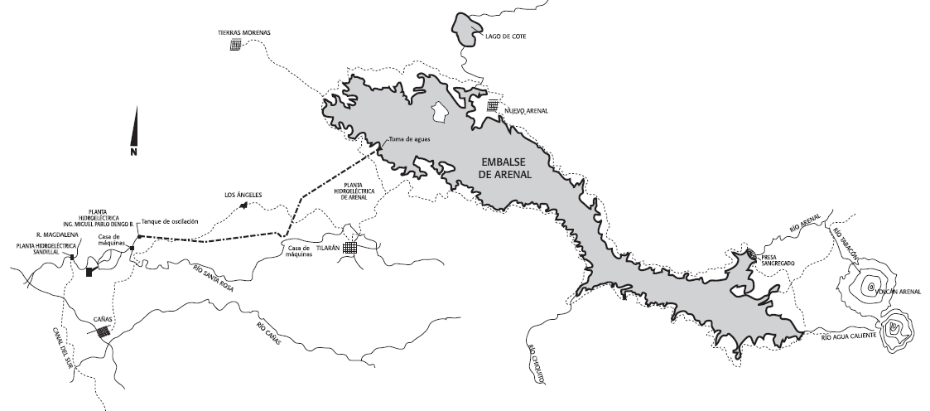
The Lake Arenal Hydroelectric Project.
Notes:
Water from Lake Arenal flows down a large-diameter tunnel to the Arenal Hydroelectric Complex (producing 640 GWh/year), from which it passes into a second tunnel to reach the Miguel Pablo Dengo B. hydroelectric plant. (producing 730 GWh/year). The Miguel Pablo Dengo B. plant is further supported by water diverted from the Santa Rosa River. After passing through this second plant, water is diverted back into the Santa Rosa River, as well as into two cement-lined irrigation canals. The remainder of the water continues to the Sandillal Hydroelectric Plant and from there into the Canal del Sur irrigation canal. Figure borrowed from the Instituto Costariccense de la Electricidad (http://www.grupoice.com/esp/cencon/pdf/ampdsan.pdf)

Slide 3
Context
The human dimension: water use and conflict in Guanacaste
The ecological dimension: preserving ecological flows to maintain ecosystem services
The hydrogeological dimension: Vulnerability of the Tempisque Aquifer as a Result of Overuse

Slide 4
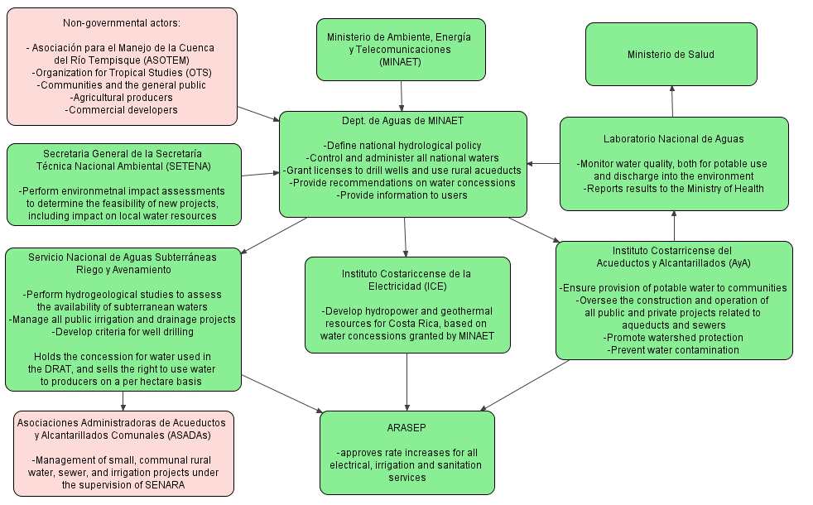
Decision makers and stakeholders
Figure 2. Governmental and non-governmental actors expected to be involved in water planning and policy in the Tempisque River Basin, Guanacaste.

Slide 5
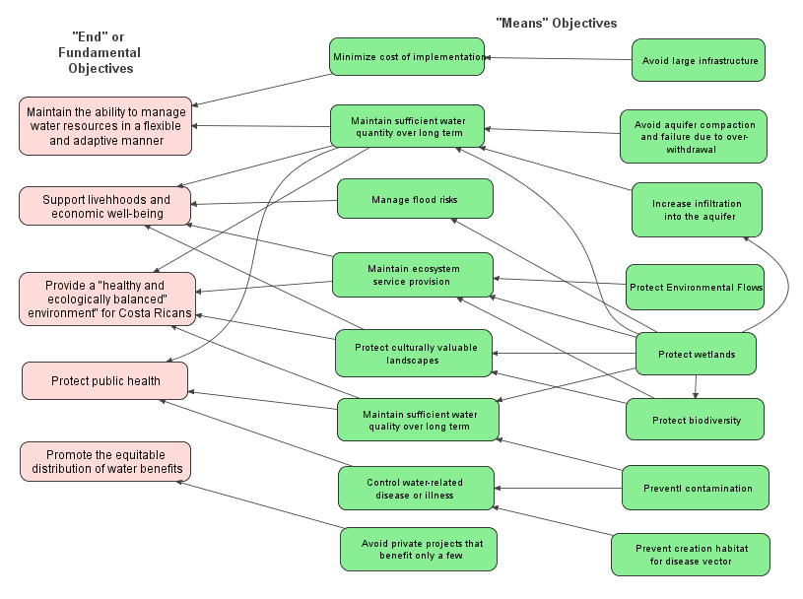
Developing objectives
Figure 3. Means-ends objective hierarchy

Slide 6
Table 1. Risks and benefits of the proposed alternative uses for water from the Arenal Hydroelectric Project
Alternative | Benefits | Tradeoffs, costs, and risks
Commit flows to the upper | -Supports the production of ecosystem services enjoyed by humans, including flood regulation and the production of commercially and ecologically important species. -Equitably beneficial | -May result in the unintentional “reclamation” of drained wetlands currently used for agriculture. -Without better control over or re-negotiation of concessions allowing withdrawals from the river, may ultimately increase total water use.
Expand irrigation projects | -Support livelihoods of agricultural producers -Relieve pressure on the in terms of the deviation of superficial flows. | -Benefits only a few families connected to the system. -Creation of habitat for vector-borne disease -Expanding cultivated area and Increasing connectivity between fields and waterways via cement channels may potentiate agrochemical, organic, and sediment contamination of the .
Create additional surface reservoirs | -Increased localized infiltration to the aquifer -Easy to access stored water. | -Loss of water through evaporation -Creation of habitat for vector-borne disease -Possible methane gas production
Aquifer Recovery and Storage | - Relieves pressure on the Tempisque aquifer and avoids future problems with compaction and reduced storativity. - Avoid evaporative waste and increases long-term storage. - Support groundwater-dependent ecosystems like the and associated wetlands through the restoration of natural discharge areas. - Equitably beneficial in the sense that ASR increases a common pool resource | - Increased cost in terms of equipment, pre-injection water purification, and pumping. - The amount of water that can be stored is constrained by the characteristics of the available formations (conductivity, storativity, connectivity to other formations) -Sustainable use is dependent on the equitable and controlled access to groundwater through MINAET concessions.
Support urban centers | -Benefits many -Relieve pressure on aquifers, allows recharge, and supports discharge to groundwater-dependent ecosystems. | -Only a temporary solution if Guanacaste’s cities continue to grow.
Support commercial development | -Indirect economic benefits to those living in touristic areas. | -Direct water use benefits to fewer people. -By permitting further coastal development through increased water supply, total water use will increase with no increase in storage.

Slide 7
Table 2. Consequence table examine the performance of each water use alternative against the stated objectives. Performance on each objective was rated using the following scale: -2, strong negative effect; -1, some negative effect; 0, no effect; 1, some positive effect; 2, strong positive effect.
Objectives & Performance Measures Alternatives | Maintain the ability to manage water resources in a flexible and adaptive manner (Volume of stored water gained per dollar spent) | Support livelihoods and economic well-being (Increased income) | Provide a “healthy and ecologically balanced” environment for Costa Ricans (Hectares of healthy wetlands) | Protect public health (Incidence of water-related disease or illness) | Ensure equitable distribution of benefits (# of people receiving direct water use benefits) | Total Score
Commit flows to the upper Tempisque River | Some infiltration; most lost to the sea 1 | Increased fishing and ecotourism income 1 | Directly supports wetlands 2 | Wetlands contribute to water purification 1 | Benefits concentrated to those closest to the river. 1 | 6
Expand irrigation projects | Some infiltration; most lost to the sea 1 | Increased agricultural income 2 | Dessication and contamination destroy wetlands -2 | Agrochemical contamination and vector habitat -2 | Benefits restricted to connected farmers -1 | -2
Create additional surface reservoirs | Some infiltration; much lost to evaporation 1 | Increased agricultural income 2 | Creates small, non-connected wetlands 1 | Vector habitat -1 | Benefits restricted to connected farmers -1 | 2
Aquifer Storage and Recovery | High infiltration; some loss to natural systems 2 | Increased agriculture, ecotourism, and fishing income 2 | Supports wetlands through discharge 1 | Clean store of drinking water is created 2 | Benefits slowly distributed to human and ecological systems throughout basin 1 | 8
Support urban centers | Permits aquifer recharge 1 | No direct effect on income 0 | Wetland destruction through contamination continues as before 0 | No direct effect on health 0 | Benefit to greatest number of people 2 | 3
Support commercial/tourism development | No storage; all water consumed through new demand -2 | Tourism income 1 | Dessication destroys wetlands -1 | No direct effect on health 0 | Largest benefits to developers; small benefits to local labour -2 | -4

